Slide 1
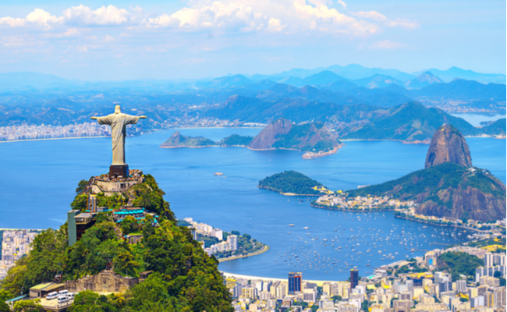
Expanding into Brazil
Where should be located the warehouse for an ecommerce business?
María Eugenia Martín Fuentes
Data Analytics Bootcamp
17th December 2020
Ironhack Berlin

Slide 2
Agenda
A little bit about Brazil
Which is the best location for a warehouse?
Where are the most of the customers?
Delivery time
Money, money, money
Conclusions
Other aspects
1

Slide 3
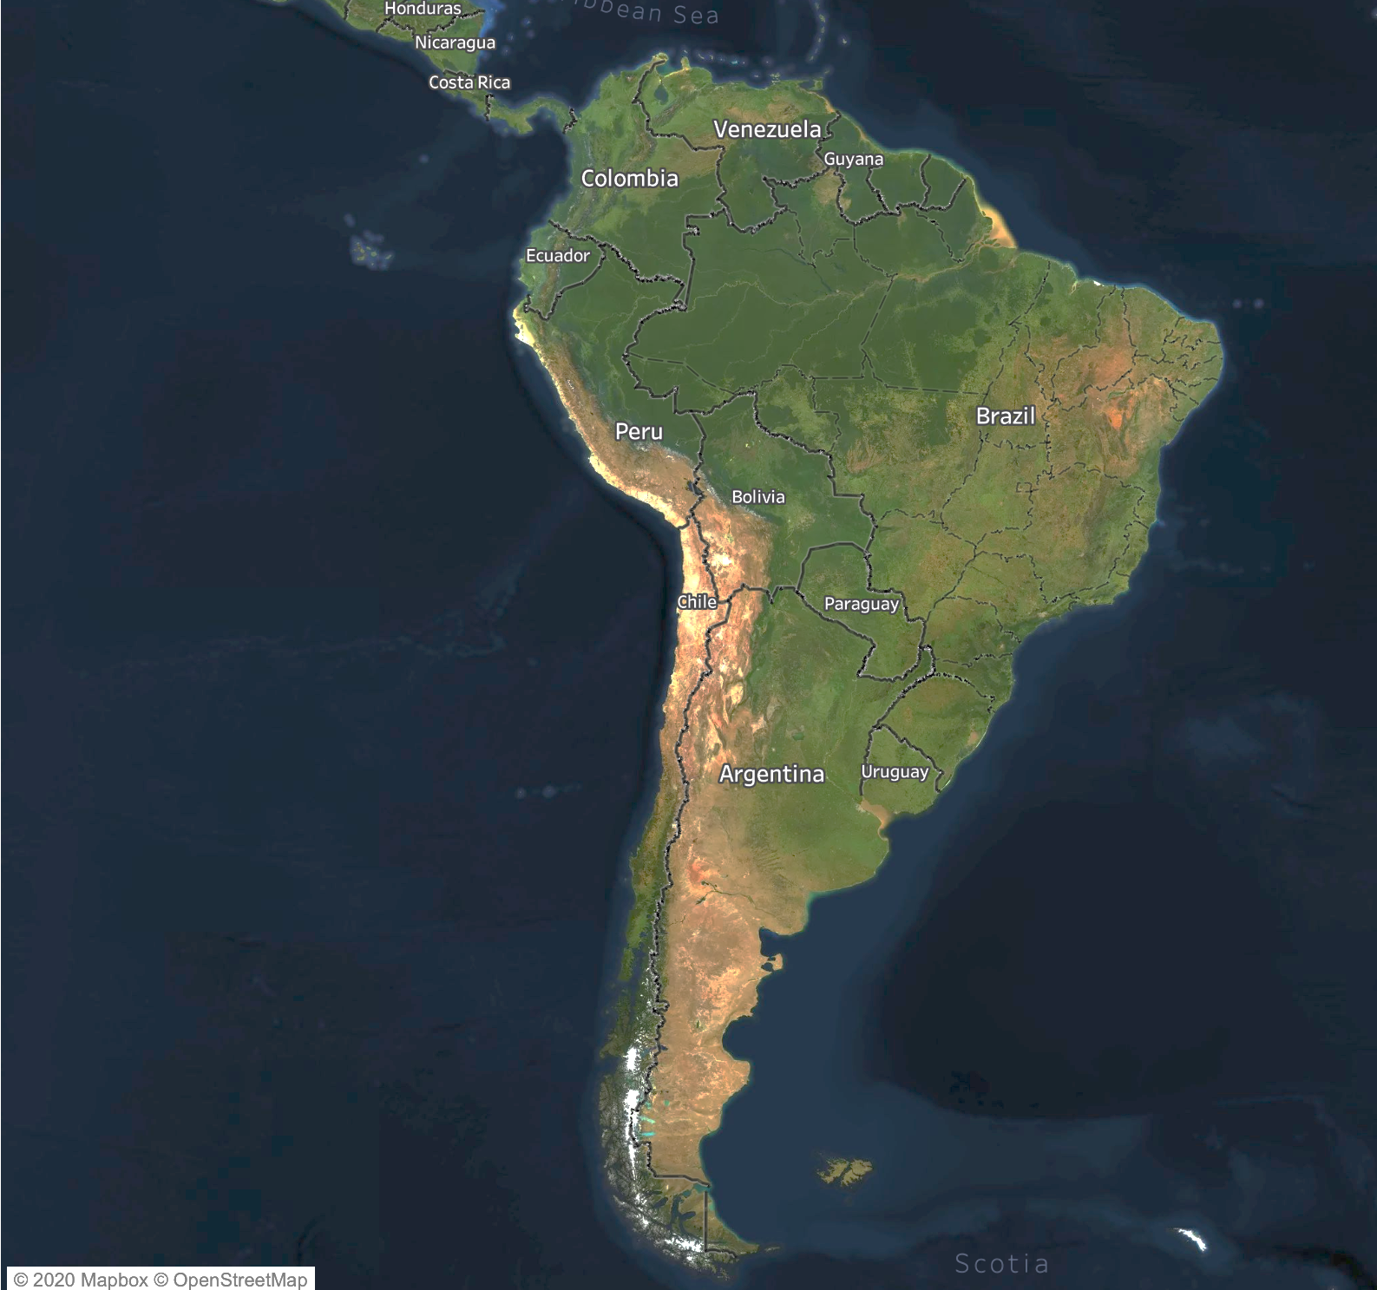
A little bit about Brazil
The largest country in both South America and Latin America
One of the nine largest emerging and developing economies
212 million people
2
Notes:
One of the nine largest emerging and developing economies by either nominal or PPP-adjusted GDP
So let’s have a look at the map of Brazil
Keeping in mind that we are in un país tropical, as the song said, we have a looooooot of green.
Since we don’t want to bother our Amazonian friends (GIFS sloth and Amazonians), the coast doesn’t seem a bad place to locate our warehouse

Slide 4
Conclusions
 | São Paulo | Minas Gerais | Rio de Janeiro | Rio Grande do Sul
Number of customers | ✓✓✓✓ | ✓✓✓ | ✓✓ | ✓
Real estate pricing | ✓ | ✓✓✓ | ✓✓ | ✓✓✓✓
Delivery time | ✓✓✓✓ | ✓✓ | ✓✓ | ✓
Results | 9 ✓ | 8 ✓ | 6 ✓ | 6 ✓
3

Slide 5
Other aspects
Conclusions based on these datasets:
Real dataset from Olist in Kaggle
Real estate listings in Brazil from Dataworld
Room for improvement:
Finding more date about industrial estate in Brazil
Checking weather conditions
Checking transport
Inferential statistics
4

